Slide 1

Exploring the Link Between Education and Illegal Pet Ownership in NYC
This presentation explores the relationship between education levels and the prevalence of illegal pet ownership in New York City's boroughs.
Yuxuan Geng, PPHA 30538 4, GitHub: emmaa1123
Kohan Chen, PPHA 30538 4, GitHub: kohaningithub
George Wang, PPHA 30538 4, GitHub: gwang613uchi

Slide 2

Our Research Focus
1
Data Exploration
2
Statistical Analysis
Analyzing NYC Open Data and US Census Bureau data on illegal pets and education attainment.
Utilizing regression models to quantify relationships between education levels and incident rates.
3
Policy Insights
Identifying potential policy responses based on key findings and areas for further research.

Slide 3
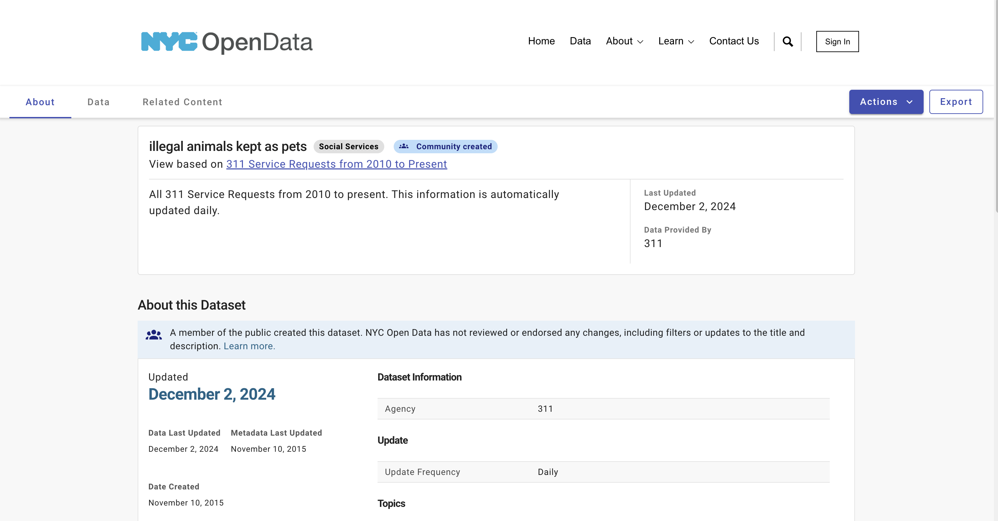
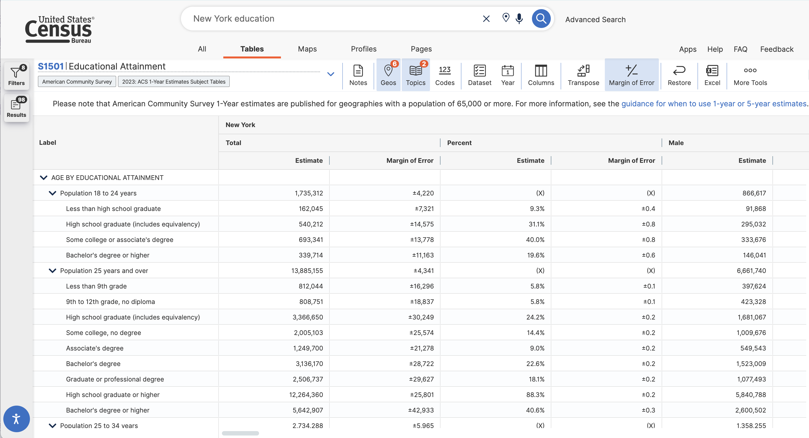
Data Sources
Illegal Pets Data
Education Attainment Data
NYC Open Data: complaint records on illegal pets
US Census Bureau: education levels for NYC boroughs

Slide 4
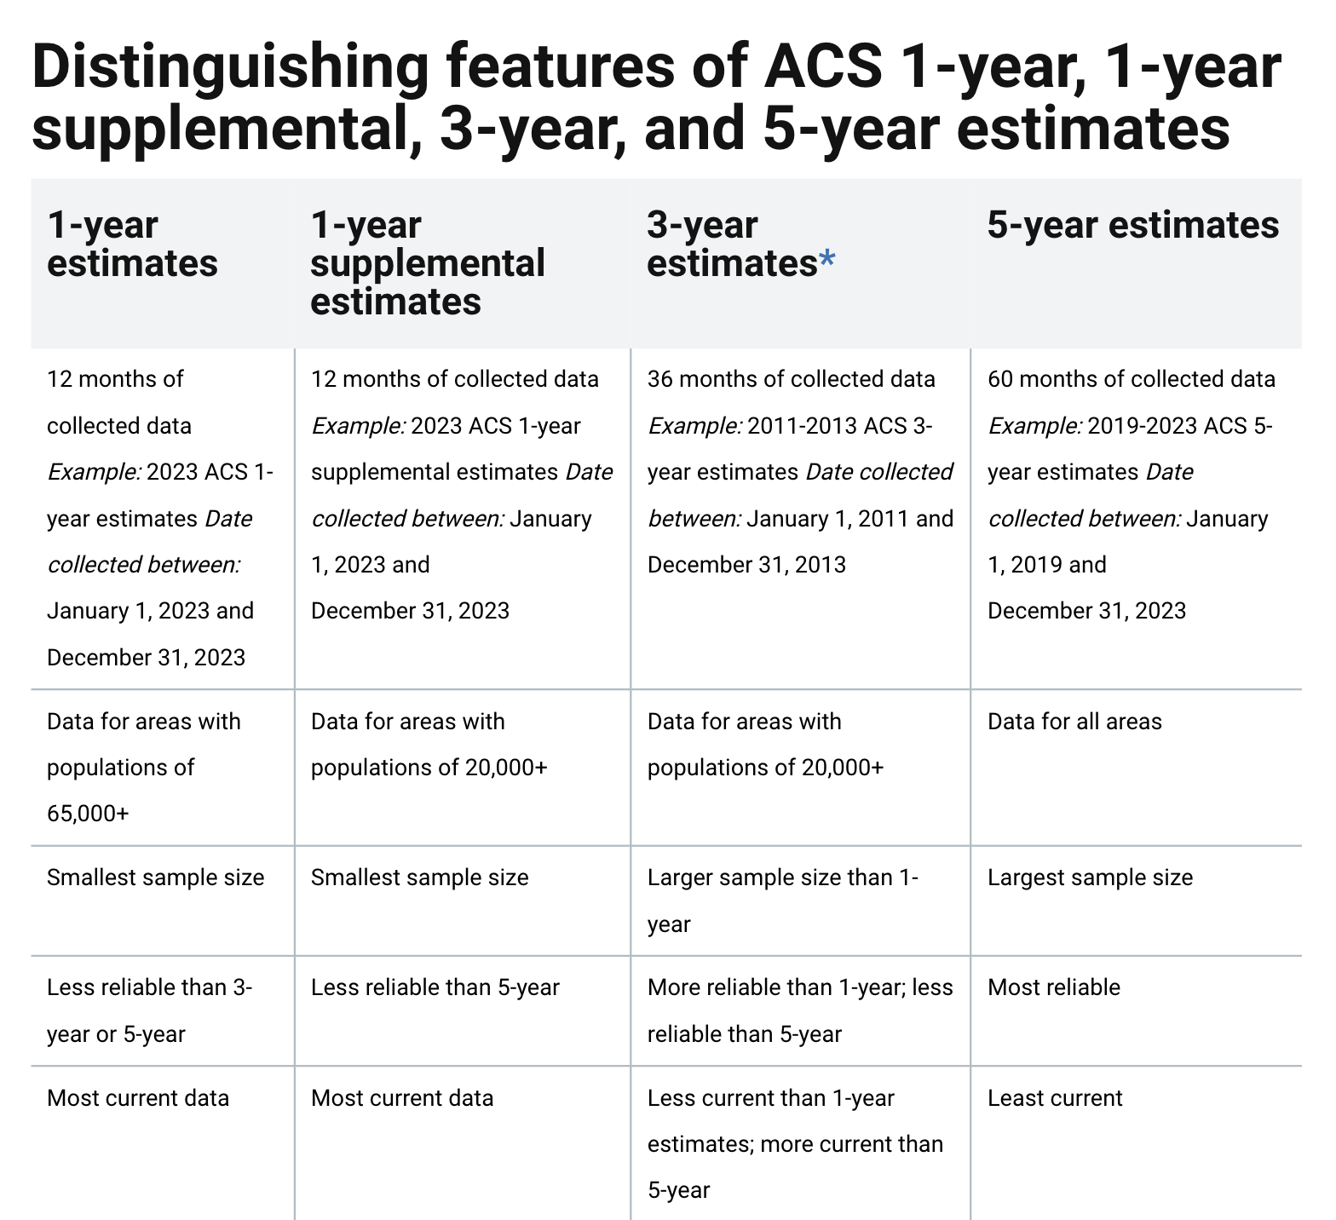
Data Sources
Education Attainment Data
We chose 5-years estimates from 2010 to 2022 because they are the most reliable indicators, though not the most current ones.

Slide 5

Data Cleaning and Standardization
Data Merging
Variable Selection
Incident Normalization
Joining annual education datasets from 2010 to 2022 to annual illegal pet incidents in NYC with time variable (in year format as the key)
Selecting the education attainment of the population aged 25 and older
Selecting variables related to incident locations and illegal pet types to connect the two datasets.
Normalizing incident counts per 10,000 people for fair comparisons because some borough might have higher population and higher incident count.

Slide 6
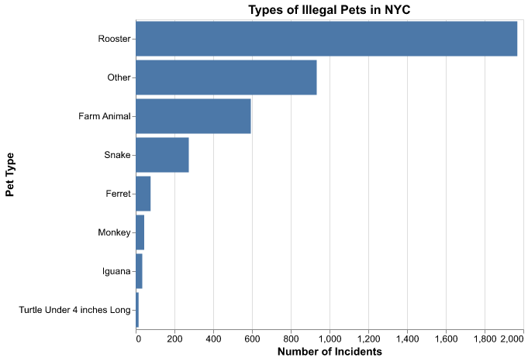
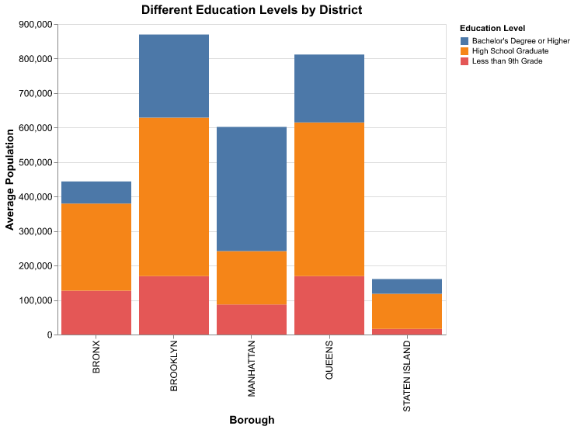
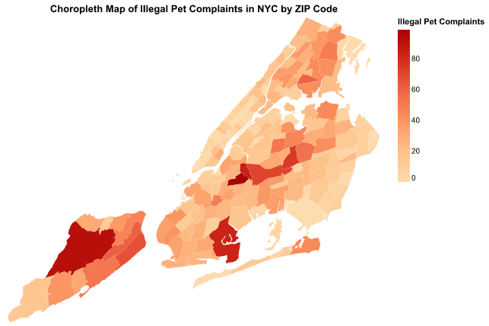
Visualizations
Types of Illegal Pets
Education Levels by Borough
Spatial Patterns of Incidents
A bar chart reveals roosters as the most common illegal pet type.
Bar chart highlights uneven distribution of bachelor degree holders among borough, with Manhattan leading in share
Choropleth map shows ZIP-level variability in illegal pet complaints, highlighting dense clusters.

Slide 7
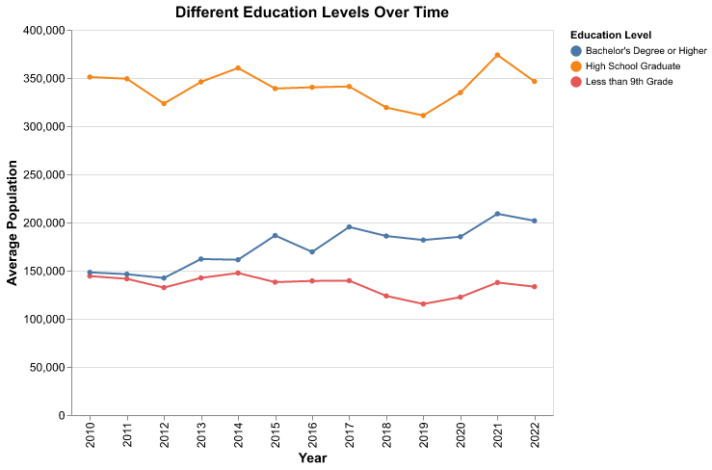
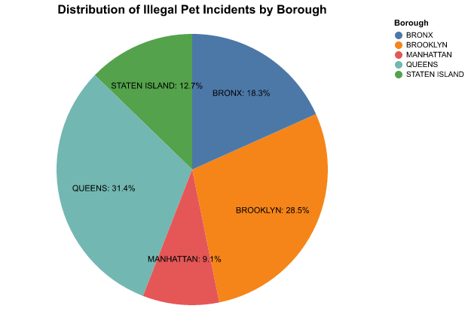
Visualizations
Education Attainment Trend
Distribution of Illegal Pet Incidents
Line plot illustrates trends in educational attainment (e.g., high school graduates, bachelor’s degrees) over the study period
Pie chart highlights the geographic distribution of incidents, with Brooklyn and Queens leading in complaint counts, reflecting their population density.

Slide 8
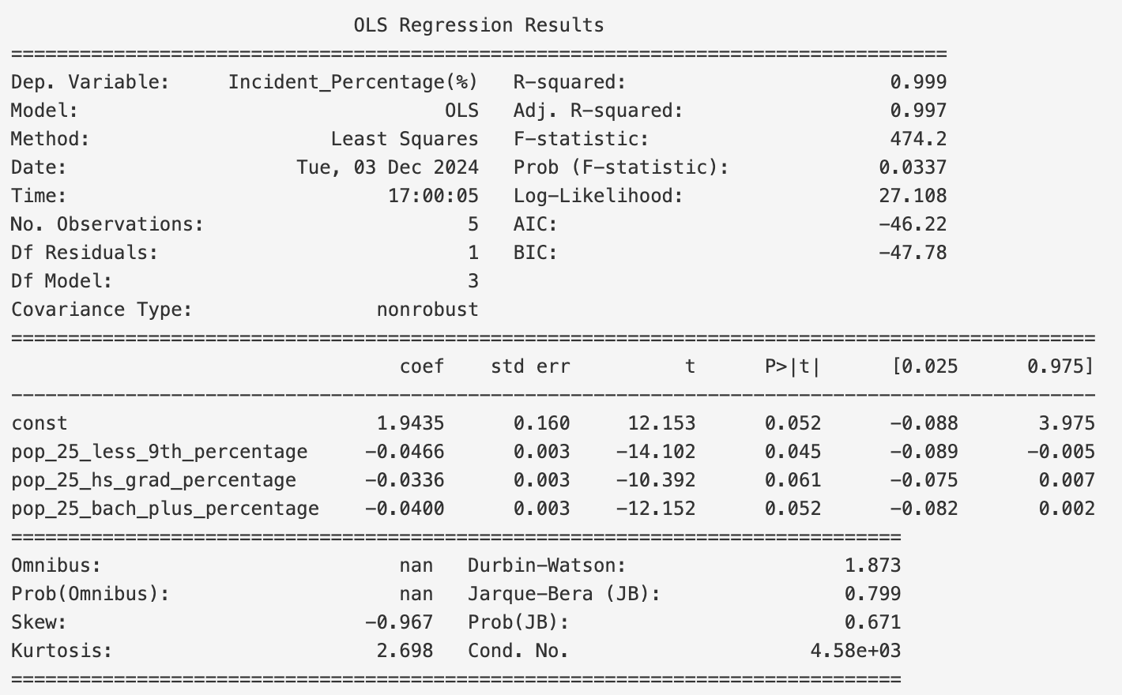
Regression Analysis Results
0.0466
Less than 9th Grade
Negative correlation between education level and incident rate.
0.0336
High School Graduates
Slight negative correlation between education level and incident rate.
0.0400
Bachelor's Degree
Negative correlation between education level and incident rate.

Slide 9
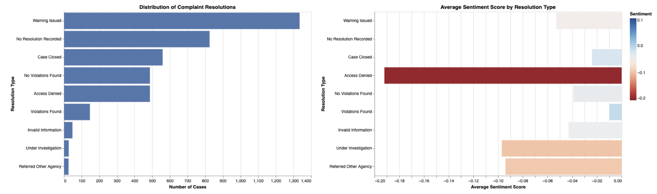
NLP Sentiment and Resolution Analysis
"Warning Issued"
Most common resolution
"Access Denied"
Most negative tone
Slightly Negative
to Neutral
Overall tone
reflecting a professional yet firm communication style

Slide 10
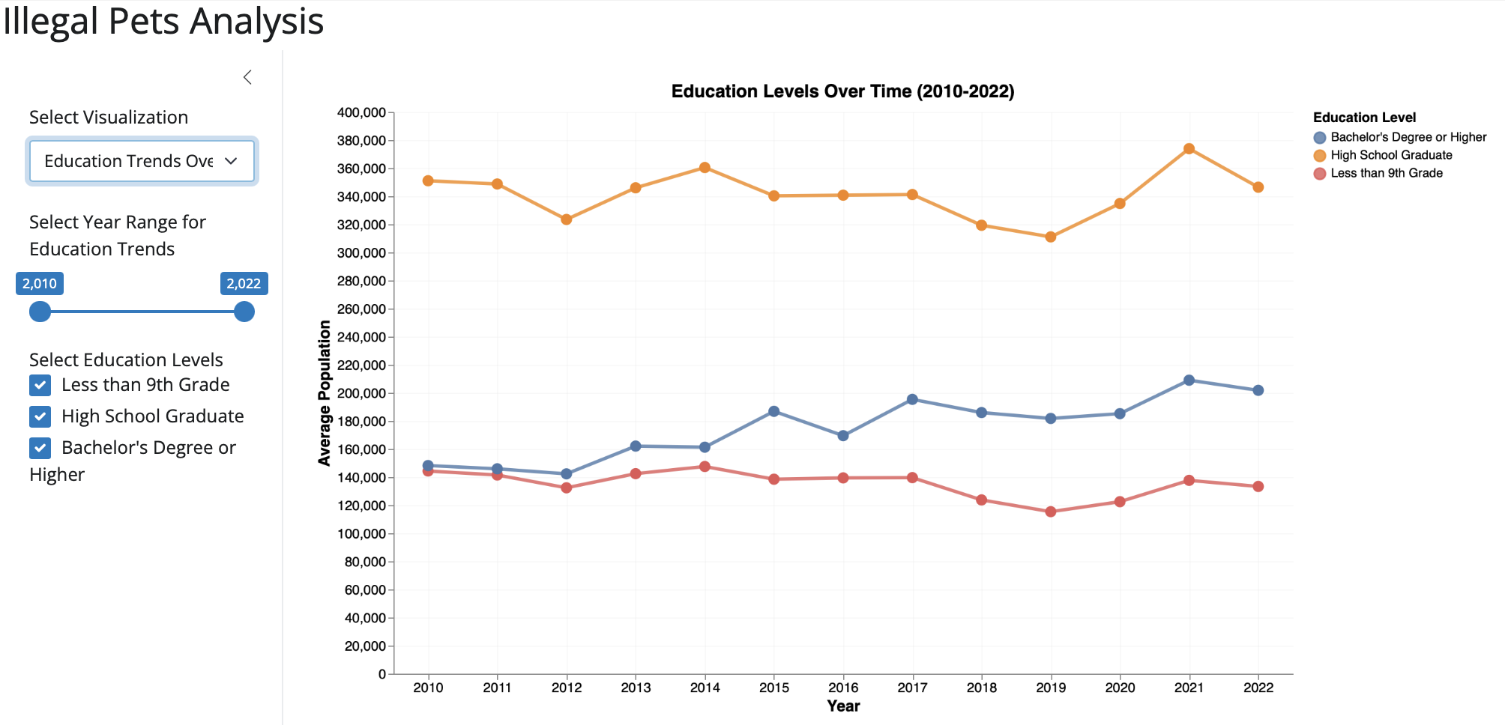
Shiny App with Interactions
With interactive toggles and checkboxes, range sliders, and range slider, users can filter data by specific years, year ranges, or education levels. These features allow them to explore the spatial and socioeconomic factors affecting illegal pet incidents.

Slide 11



Key Findings and Limitations
Minimal Influence
1
Weak correlations between education and illegal pet ownership.
Borough Variability
2
Staten Island exhibits higher-than-predicted incident rates.
Spatial Clusters
3
ZIP-level analysis highlights areas with dense complaint clusters.

Slide 12
Policy Implications and Next Steps
Community Outreach
1
Educational campaigns in high-incident areas.
Enhanced Enforcement
2
Strengthening monitoring and reporting in areas with dense clusters.
Broader Analysis
3
Exploring additional factors like income, housing, and culture.

Slide 13

Future Directions for Research
Neighborhood-Level Data
Interactive Tools
Examining localized trends and variations.
Developing tools to engage the public and policymakers.
1
2
3
Socioeconomic Factors
Exploring income, housing, and cultural influences.

